Slide 1

Cyber Presentation
Group Members :
Muhammad Talha Ilyas
Ali Jarar Haider
Shahzaib Ali

Slide 2
Introduction to Fire Wall
Firewalls are both software programs and hardware components that preserve our security and maintain safety from unauthorized access to or from the external network.
They act as a vital part of a comprehensive security framework for any network.
It inspects every packet that comes (inbound) and goes out (outbound) of it and used for your purpose, and it determines whether it needs to be passed or blocked.
In short, firewalls defend our resources by validating access, managing and organizing legitimate network traffic, acting as an intermediary, and records and reports different events.

Slide 3
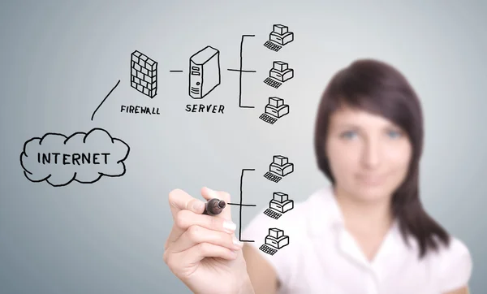
Security analysts get specialized training to set policies and access norms for firewalls to filter and monitor and restrict unintended data packets to pass through them.

Slide 4
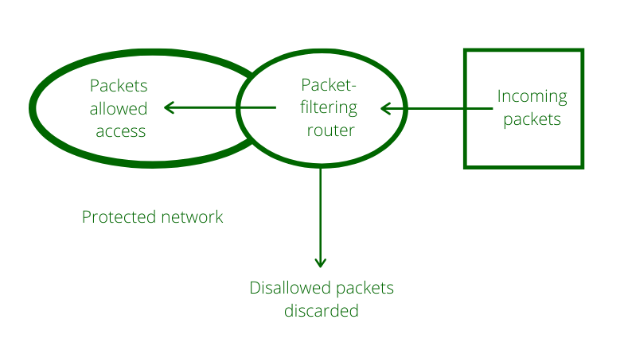
Types Of Fire Wall
Packet Filtering Firewall: It is the first of its kind used for network security and is accountable for filtering and checking incoming data packets, allowing data from specific IP addresses, types of packets, specific port numbers, etc

Slide 5
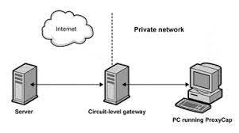
Circuit Level Firewall:
A circuit-level gateway firewall helps in providing the security between UDP and TCP using the connection. It also acts as a handshaking device between trusted clients or servers to untrusted hosts and vice versa.

Slide 6
Stateful Inspection Firewall:
It is used for filtering both data packet as well as session filtering. It checks for active sessions and network packets, whether they are legitimate or not.
Stateful inspection is the kind of network firewall technology that filters data packets supported by state and context. Check Point Software Technologies (CPST) developed the technique within the early 1990s to overcome the restrictions of stateless inspection.

Slide 7
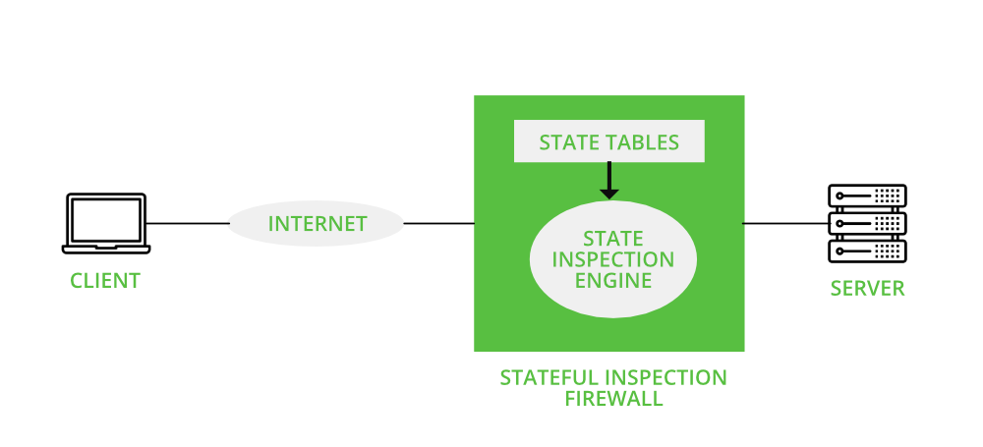
Working Methodlogy of statefull inspection firewall
.

Slide 8
Application Level Firewall:
Application-level gateway is also called a bastion host. It operates at the application level. Multiple application gateways can run on the same host but each gateway is a separate server with its own processes.
It functions at the application layer. Filtering of traffic is done concerning the application (or service) for which they are planned.

Slide 9
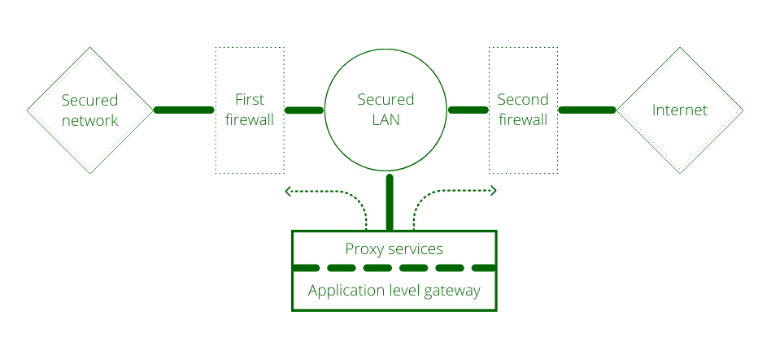
Working methodology of Application firewall
.

Slide 10
Distributed firewall
A distributed firewall is a host-resident security software application, which protects the network as a whole against unwanted intrusion. Deployed alongside more traditional firewalls, distributed firewalls can add another layer of protection to a network while still maintaining high throughput for legitimate network traffic.
This model fails, however, if an attack comes from inside the network — an all-too-common occurrence given the huge variety of ways that users can connect to an internal network, including wireless access and VPN tunnels. Traditional firewalls typically can’t effectively guard against attacks coming from sources like these, but a distributed firewall can add another layer of defense against this type of attack.

Slide 11
Distributed firewalls have a standard set of capabilities:
Centralized Management:Though distributed firewalls don’t exist in just one place, they do typically offer the ability to configure and "push out" consistent security policies.
Fine-Grained Access Control:Distributed Firewalls allow for fine grained access control, which standard firewalls cannot readily accommodate without greatly increasing their complexity and processing requirements.
Pull and Push Distribution:Distributed firewalls typically support both “pull” and “push” methods of distribution – the former involving pinging the central management server to check whether it’s up and active, then requesting its policies, and the latter ensuring that the hosts always have their updated policies at all times.

Slide 12
Why a distributed firewall is important ?
Traditional physical and virtual firewalls have started to hinder assurances of modular protection in modern network environments. Distributed firewalls can work as a additional fix for some new problems that arise when dealing with the challenges of maintaining a secure network in a business environment. The ability for distributed firewalls to maintain internal and external security, along with the theoretically limitless expansion properties, make them a useful tool for IT security.

Slide 13
Benefits of using Fire Wall
It stops attacks on your network from external networks and agents.
It acts as a filter and keeps away the non-authoritative users.
It permits monitoring the network security and alarms its users when any malicious activity is detected.
IT also observes and records services used by WWW (World Wide Web), FTP (File Transfer Protocol), and some other commonly used protocols.
It also blocks or un-block those inbound and outbound packets.

Slide 14
Virtual Protection Network
A virtual private network, better known as a VPN, protects your online activity and privacy by hiding your true IP address and creating a secure, encrypted tunnel to access the internet. No snoops, trackers, or other interested third parties will be able to trace your online activity back to you.
You can reach a new level of internet freedom by using servers across different countries to unblock restricted content. While you could use this ability to open unlimited libraries of Netflix content, it also allows you to access international news or media that might be censored under oppressive regimes.
Some famous VPN are Nord vpn, Hotspot shield , Express vpn.

Slide 15
Types Of VPN
Remote Access VPN: Remote Access VPN permits a user to connect to a private network and access all its services and resources remotely. The connection between the user and the private network occurs through the Internet and the connection is secure and private. Remote Access VPN is useful for home users and business users both.
Site to Site VPN: A Site-to-Site VPN is also called as Router-to-Router VPN and is commonly used in the large companies. Companies or organizations, with branch offices in different locations, use Site-to-site VPN to connect the network of one office location to the network at another office location.

Slide 16
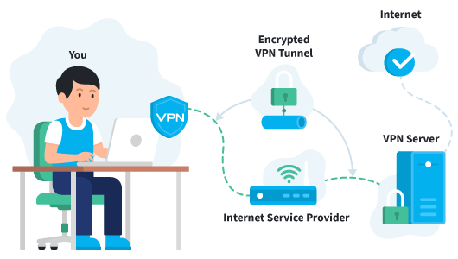
How VPN Works?
The VPN client software on your computer encrypts your data traffic and sends it to the VPN server through a secure connection. The data goes through your ISP, but it’s become so scrambled due to the encryption they can no longer decipher it on their end.
The encrypted data from your computer is decrypted by the VPN server.
Your data is then sent to the internet and receives a reply that’s meant for you, the user.
The traffic is then encrypted again by the VPN server and is sent back to you.
The VPN client on your device will decrypt the data so you can actually understand and use it.

Slide 17
Advantages
VPNs Get Rid of Geo-Restrictions
With a VPN, Your Online Privacy Is No Longer at Risk
VPNs Keep You Safe from Online Censorship
Downloading Torrents Is No Longer Risky With a VPN
VPNs Protect You from Cybercriminals
A VPN Can Prevent Bandwidth Throttling
VPN Can Bypass Firewalls

Slide 18
Disadvantages
A VPN won’t give you complete anonymity
Your privacy isn’t always guaranteed
Using a VPN is illegal in some countries
A safe, top-quality VPN will cost you money
VPNs almost always slow your connection speed
Using a VPN on mobile increases data usage
Some online services try to ban VPN users:
It won’t protect you from malware or phishing attacks

Slide 19
VPN in Pakistan
As per the National Security Agency (NSA) leaks by Edward Snowden, the United States spied the most on Iranian citizens using surveillance technology, followed by Pakistani citizens.
The Pakistani state agencies itself has the capacity for surveillance of unencrypted internet traffic, using the Web Monitoring System (WMS) which was purchased for a whopping $18 million form Canadian agencies in December 2018.
The ban is aimed at curbing illegal VoIP traffic, also known as grey traffic. VoIP is a technology that allows users to make a call, including on a landline or mobile number, from a computer software.

